Slide 1
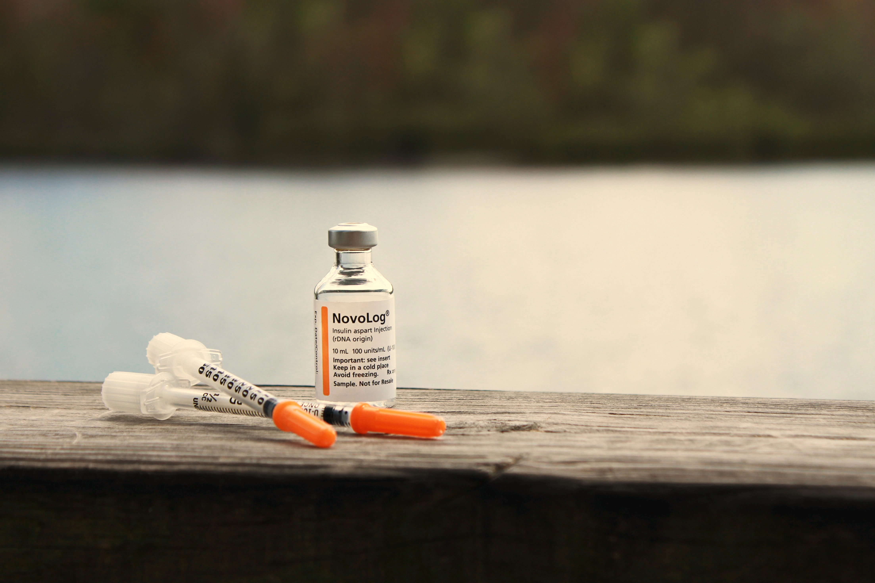
Mathematical Model for BCG-based Treatment Of Type 1 Diabetes
Presented by Dr. Teddy Lazebnik @ University College London 19.09.2022

Slide 2
Special Thanks
The work presented today is the result of a fruitful collaboration with:
Dr. Svetlana Bunimovich - Ariel University, Israel
Dr. Alex Kiselyov - 7 Institutskiy Per., Russian Federation

Slide 3








Agenda
Motivation
Background
Model definition
Biological processes
Mathematical modelling
Numerical simulation & Results - with focus on personalized treatment
Summary & Conclusion

Slide 4
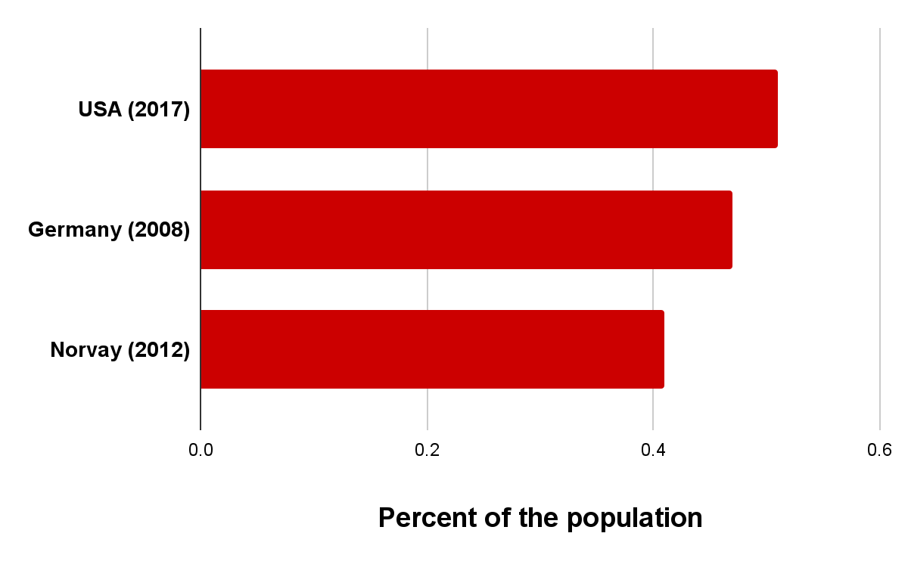
Motivation
Type 1 diabetes (T1D) declared a pandemic in 1994, second in death rate in OECD countries to oncology and heart-related diseases. T1D is one of the most common chronic diseases of childhood.

Slide 5
Motivation - some statistics
According to the US Diabetes Association, in 2019:
Diabetes was the seventh leading cause of death with 283K death certificates mentioning it as a leading cause.
Total cost of diagnosed diabetes was $327B with $237 in direct costs and $90B from reduced productivity.
1.9 million Americans, or 0.56% of the USA population, had T1D.

Slide 6
Background – symptoms
According to the American diabetes association, symptoms:
Feeling more thirsty than usual.
Feeling very hungry.
Feeling irritable or having other mood changes.
Having blurry vision.
Notes:
לכתוב יותר פשוט ולהכניס סימפטומים

Slide 7
Background: The amazing BCG
BCG is an attenuated non-pathogenic strain of Mycobacterium bovis used as a vaccine for the prevention of tuberculosis.
1884: Kock demonstrates Mycobacterium tuberculosis.
1894: Calmette & Guerin begin race for tuberculosis vaccine at Institute Pasteur, France.

Slide 8
Background: The amazing BCG (cont.)
1929: Pearl in autopsy studies notes protective effect of BCG against cancer.
1976: Dr. Alvaro Morales published paper in the Journal of Urology on the use of intravesical BCG for the bladder cancer.
2017: BCG has shown promise for the treatment of malignancies, such as melanoma leukemia and lymphoma.
2022: Multiple BCG vaccinations for prevention of COVID-19 and other infectious diseases in Type 1 diabetes.

Slide 9
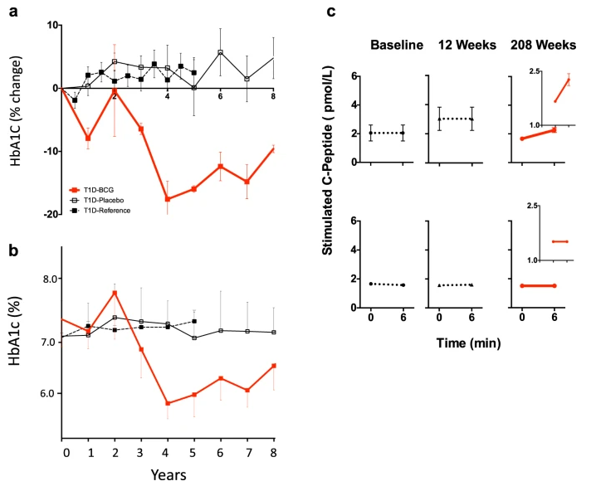
Background – Kuhtreiber et al. (2018)
Conducted a randomized eight-year-long prospective examination of T1D patients with the long-term disease who received two doses of BCG vaccine
* W. M. Kuhtreiber, L. Tran, T. Kim, M. Dybala, B. Nguyen, S. Plager, D. Huang, S. Janes, A. Defusco, D. Baum, H. Zheng, and D. L. Faustman. “Long-term reduction in hyperglycemia in advanced type 1 diabetes: the value of induced aerobic glycolysis with BCG vaccinations”. In: NPJ vaccines 3.23 (2018).

Slide 10
Model Definition – introduction
We are looking on the cell-level interaction between different cells related to the insulin-BCG-immune system. Namely:
B – BCG-cells
M_R – Resting macrophages
M_A – Active macrophages
D – Dendritic cells
T – Autolytic T cells
Beta – Beta cells

Slide 11
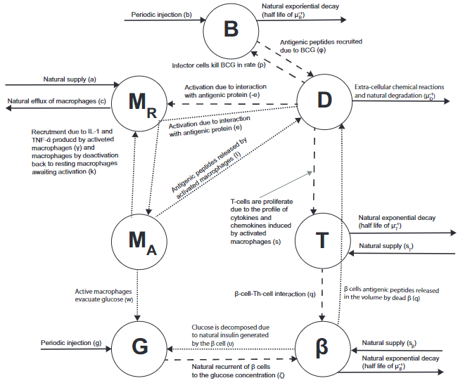
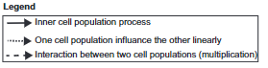
Model Definition – biological processes

Slide 12
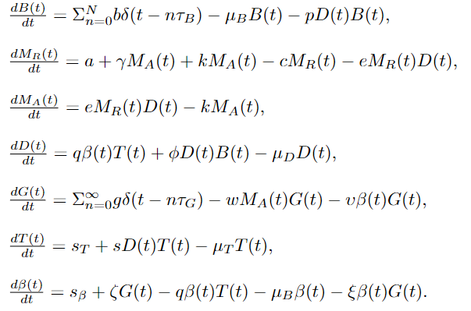
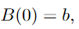
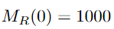
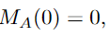
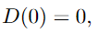
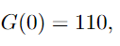
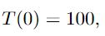
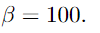
Model Definition – mathematical model
Initial condition:

Slide 13
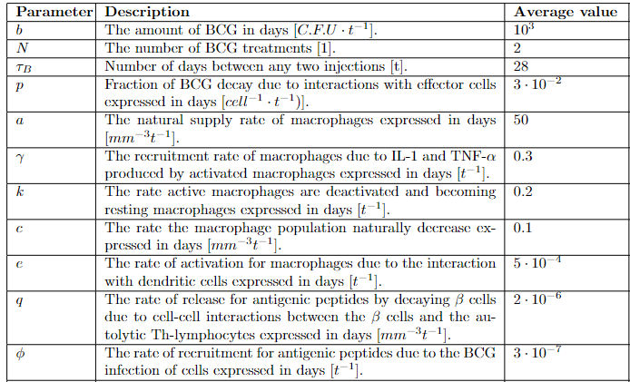
Model Definition – parameter values

Slide 14
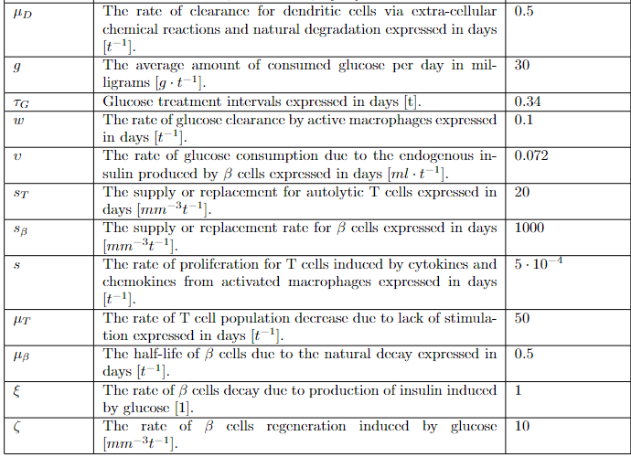
Model Definition – parameter values

Slide 15
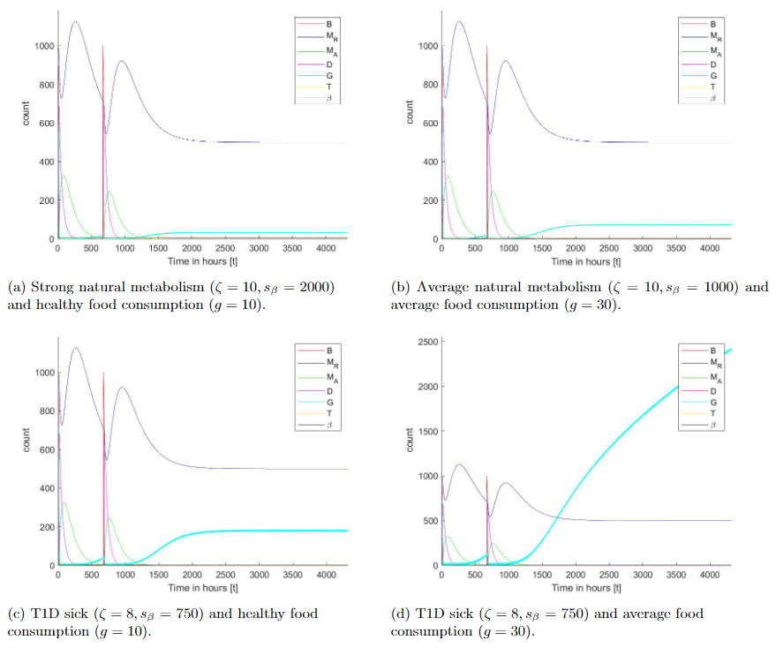
Numerical Simulations - baseline
We solve the proposed
system using Matlab’s
ODE15 function (2020b).

Slide 16
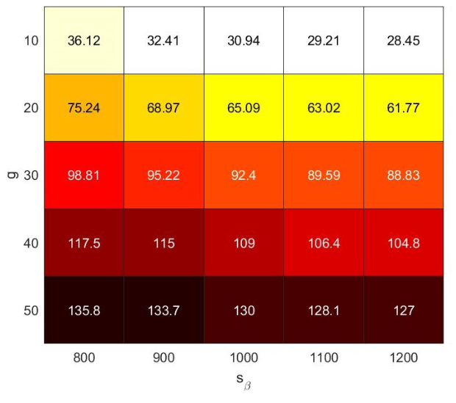
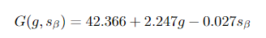
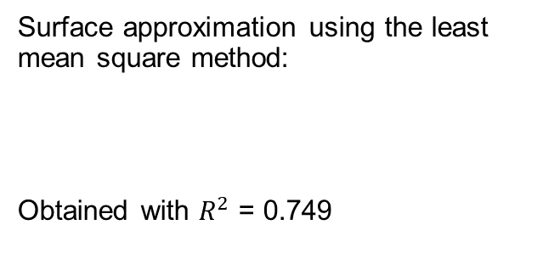
Numerical Simulations – sensitivity
Average glucose levels three month after the last BCG treatment
Surface approximation using the least mean square method:
Obtained with $R^{2}$ = 0.749
* N = 2, b = 1000, tau_g = 8

Slide 17
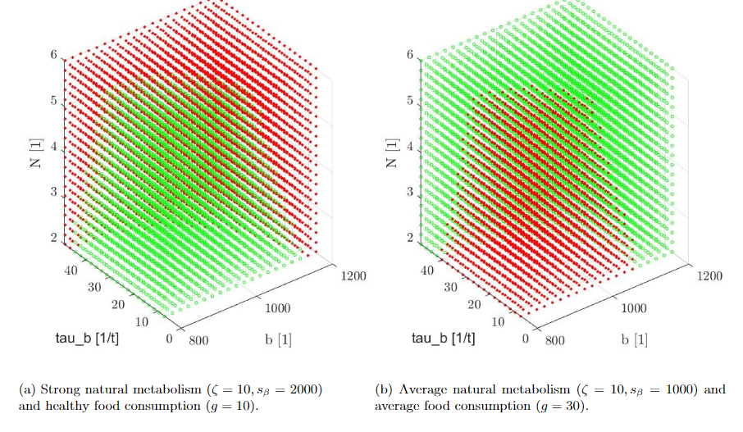
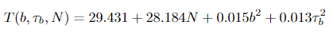
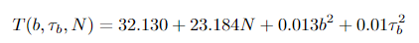
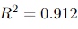
Numerical Simulations – personalized treatment

Slide 18
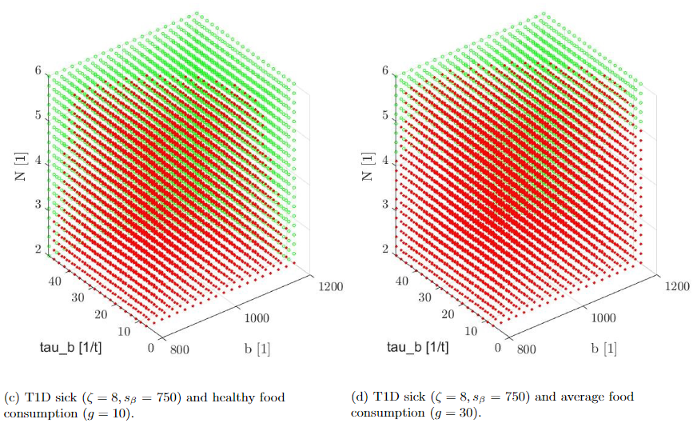
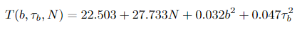
Numerical Simulations – personalized treatment

Slide 19
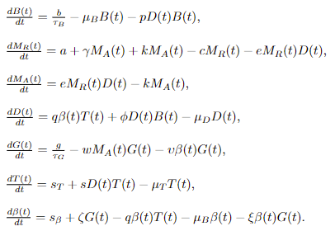
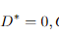
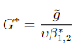
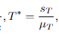
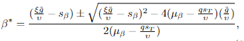
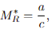
Numerical Simulations – equilibria analysis (1)

Slide 20
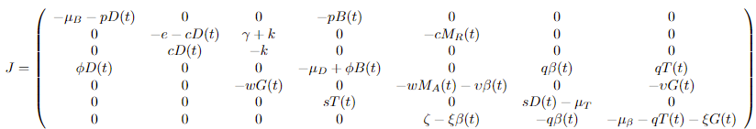
Numerical Simulations – equilibria analysis (2)
We computed the Jacobian matrix of the system of experiments:

Slide 21
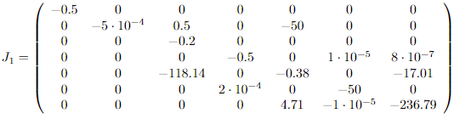
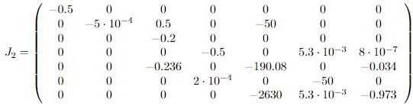
Numerical Simulations – equilibria analysis (3)
We set the values from the table and the two values of Beta:
$$J_{1}=\left[−0.005, −236.45, −0.7194, −0.5, −0.2, −50, −0.5\right], J_{2}=[−0.005, −50, −190.551, −0.5, −0.5013, −0.5, −0.2]$$

Slide 22
Numerical Simulations – equilibria analysis (4)
We define the healthy equilibrium to be the steady state in which the glucose levels are in the middle of this range (e.g., $G^{∗} = h = (l_{b}+ u_{b})/2$) and no BCG is administered ($B^{∗}= 0$). In this case, the equilibrium looks as follows:
such that
This equilibrium is not biologically feasible (i.e., a biological system cannot reach such state in practice) as
$$M_{A}^{∗}>0$$

Slide 23
Numerical Simulations – equilibria analysis (5)
In order to evaluate the case where $M_{A}^{∗}=0$, we get that:
Therefore,

Slide 24

Summary
Glucose consumption exerts more influence (factor ~100) on the disease progression than metabolism, especially when evaluated over a short-medium period.
The BCG treatment may still benefit healthy controls on a high-glucose diet.
The injection of BCG can provide long-range health benefits, which agrees with the outcomes of the clinical experiment conducted by Kuhtreiber et al. (2018)
The sensitivity of the BCG injection on the glucose level is reproducing the same trends of the in vivo experiment conducted by Kuhtreiber et al. (2020)

Slide 25



Wrapping it up
A pre-print of the paper describing this research is available at:
https://doi.org/10.1101/2021.09.02.458659
I am always looking for exciting projects, feel free to PM via:
t.lazebnik@ucl.ac.uk
teddylazebnik.info

